Slide 1
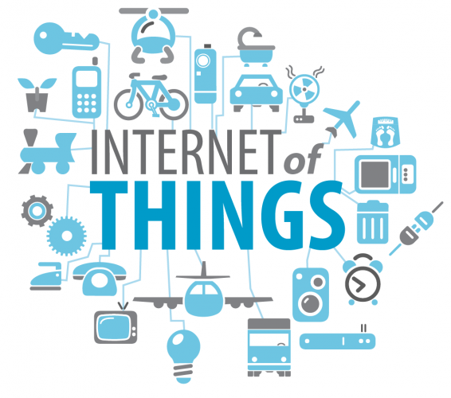
Introduction to IoT

Slide 2

What is IoT
Network of Physical Objects
Internet of Things (IoT) comprises things that have unique identities and are connected to the Internet
The focus on IoT is in the configuration, control and networking via the Internet of devices or “Things” that are traditionally not associated with the internet
Eg: pump, utility meter, car engine
IoT is a new revolution in the capabilities of the endpoints that are connected to the internet

Slide 3
What is IoT
Network of Physical Objects
The Scope of IoT is not limited to just connecting things (device, appliances, machines) to the Internet
IoT allows these things to communicate and exchange data (control& information)
Processing on these data will provide us various applications towards a common user or machine goal

Slide 4

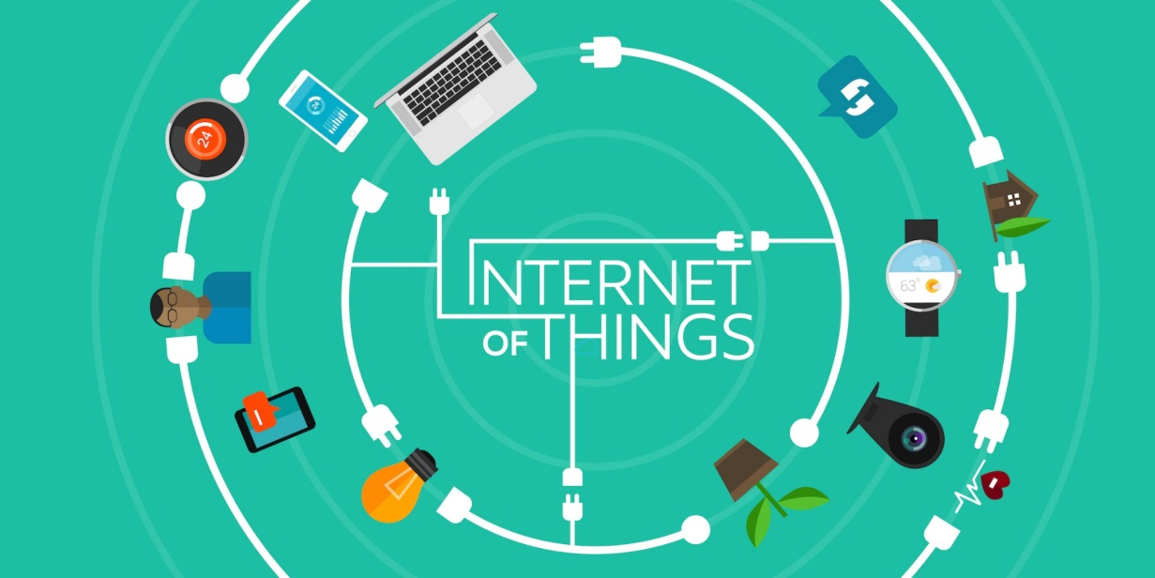
Idea: Move from Internet of People → Internet of Things
Internet appears everywhere in the world
It is primarily connection between people
Internet of Things is a plan to connect things also using the same medium

Slide 5
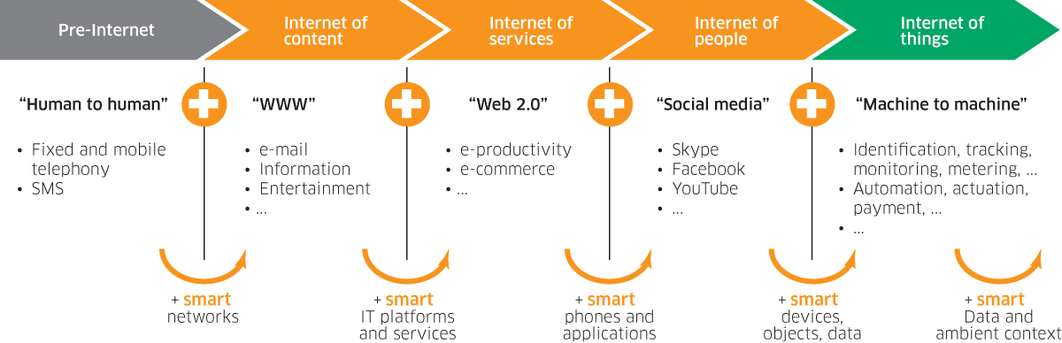
Internet of Things - Evolution

Slide 6
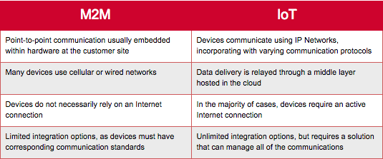
Difference between M2M and IoT

Slide 7




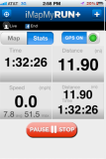
IOT: People connecting with Things
ECG sensor
Internet
Motion sensor
Motion sensor
Motion sensor

Slide 8
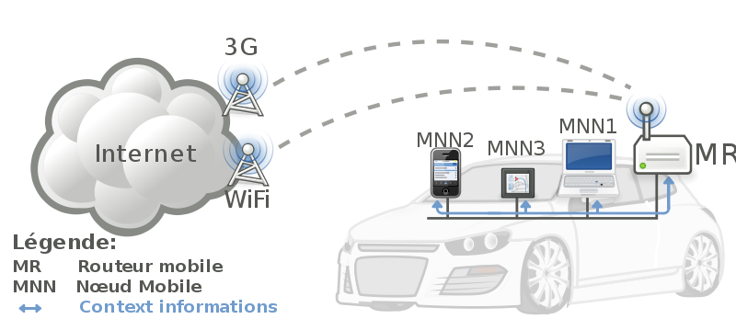


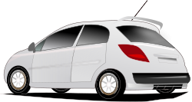
IoT: Things connecting with Things
- Complex and heterogeneous
resources and networks

Slide 9
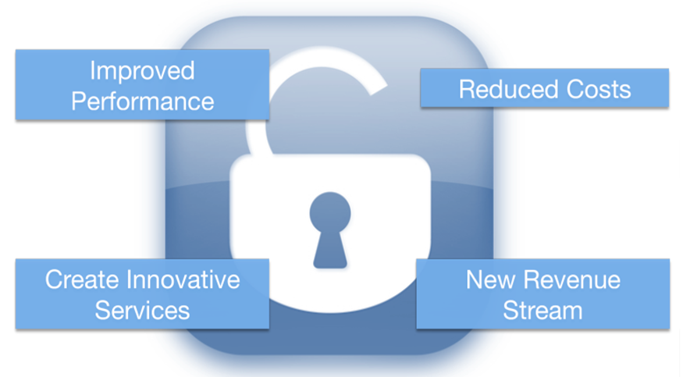
Unlocking the Massive potential of IoT

Slide 10
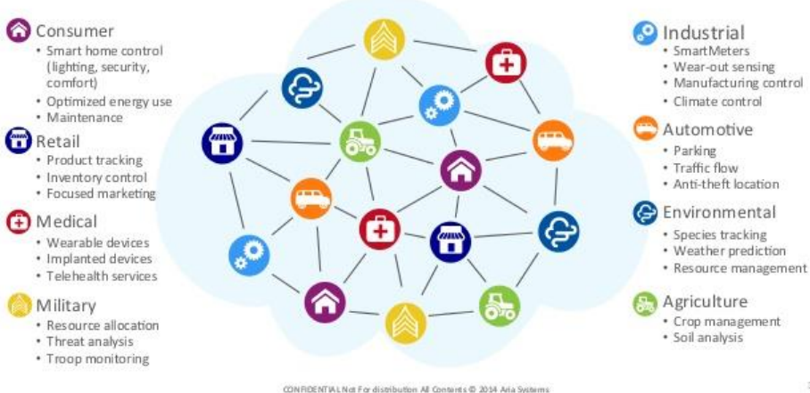
Looming Opportunity

Slide 11
Applications of IoT

Slide 12
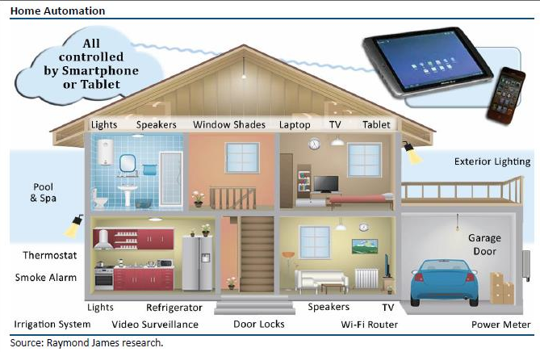
IoT Applications : Intelligent Home

Slide 13
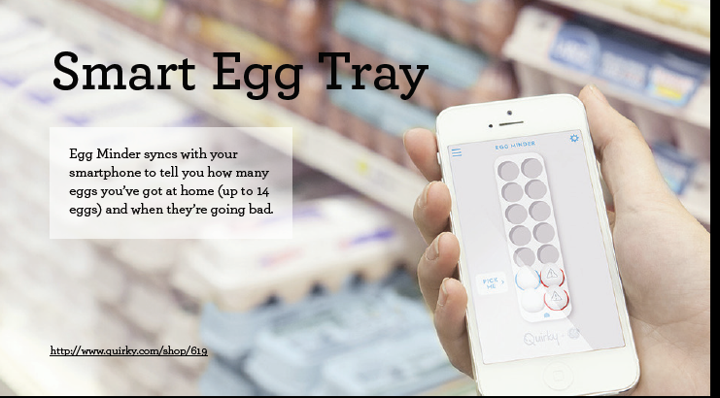

Slide 14
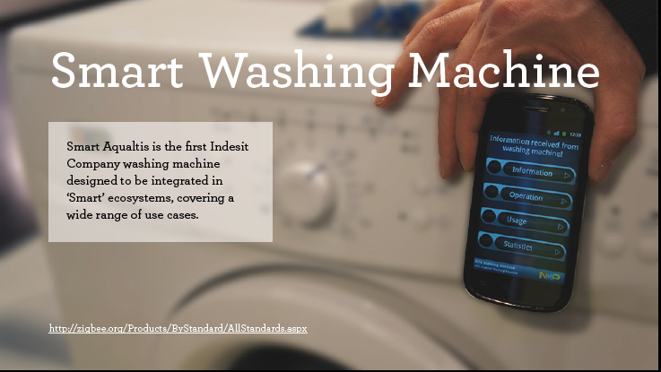

Slide 15
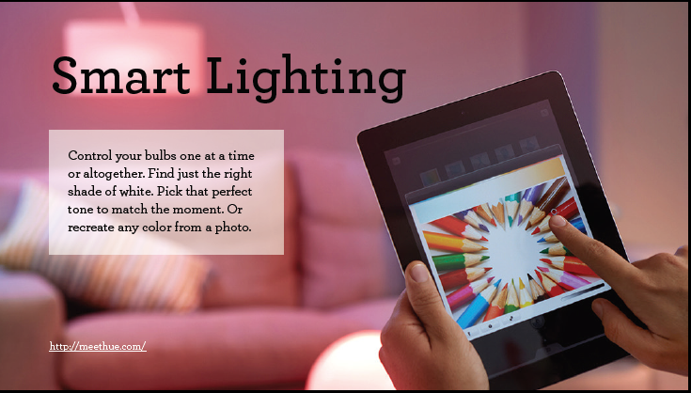

Slide 16
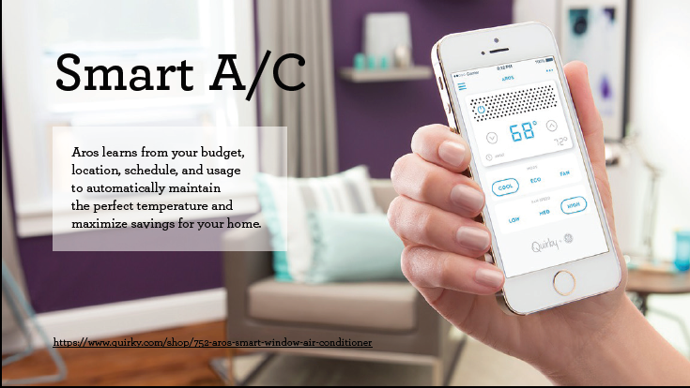

Slide 17
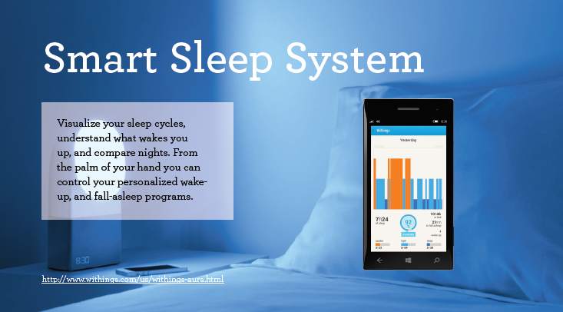

Slide 18
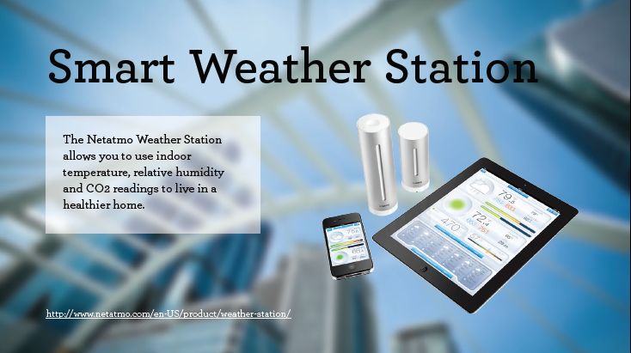

Slide 19
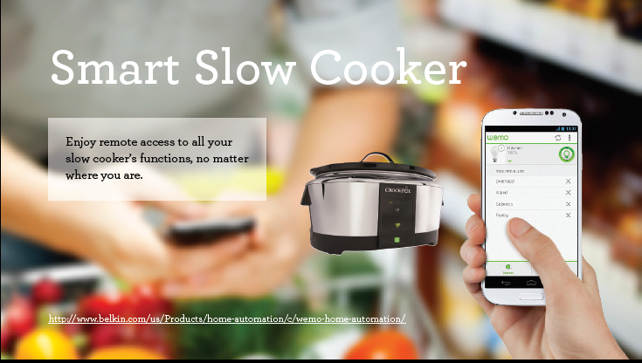

Slide 20
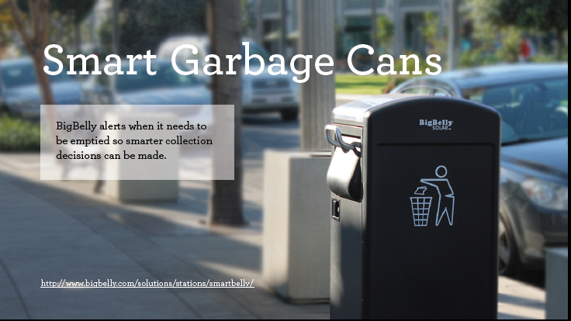

Slide 21
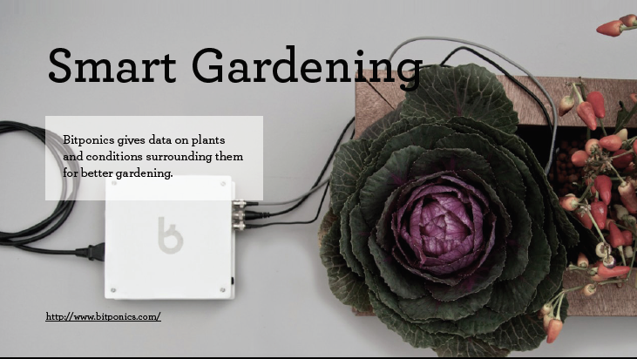

Slide 22
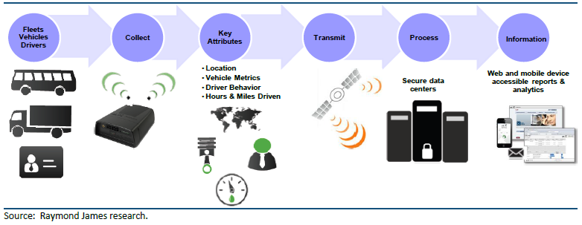
IoT Applications : Transportation

Slide 23
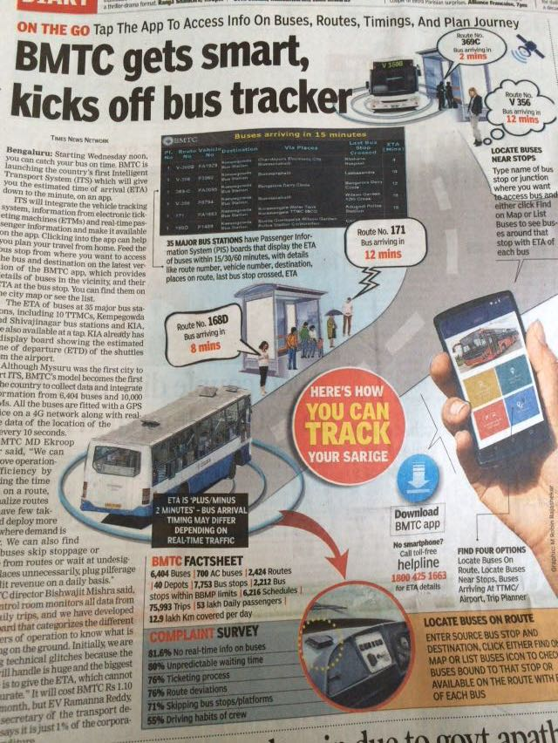
IoT Applications : (BMTC)Transportation

Slide 24
Supply Chain Management
Logistic
Product Design
Warehouse
Manufacturing

Slide 25
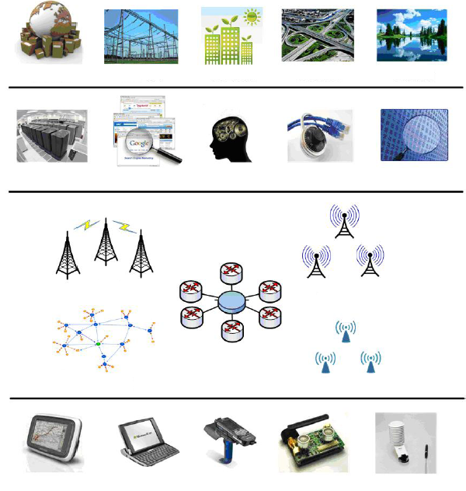
IoT Architecture
Integrated Application
Smart Grid
Green Building
Smart Transport
Env. Monitor
Information Processing
Data Center
Search Engine
Smart Decision
Info. Security
Data Mining
WWAN
WMAN
Network Construction
Internet
WPAN
WLAN
Sensing & Identification
GPS
Smart Device
RFID
Sensor
Sensor

Slide 26
IoT Technologies

Slide 27
IoT Technologies
Hardware (Device)
Communication Technology
Protocols for IoT
Software (IDE)
Cloud Platforms

Slide 28
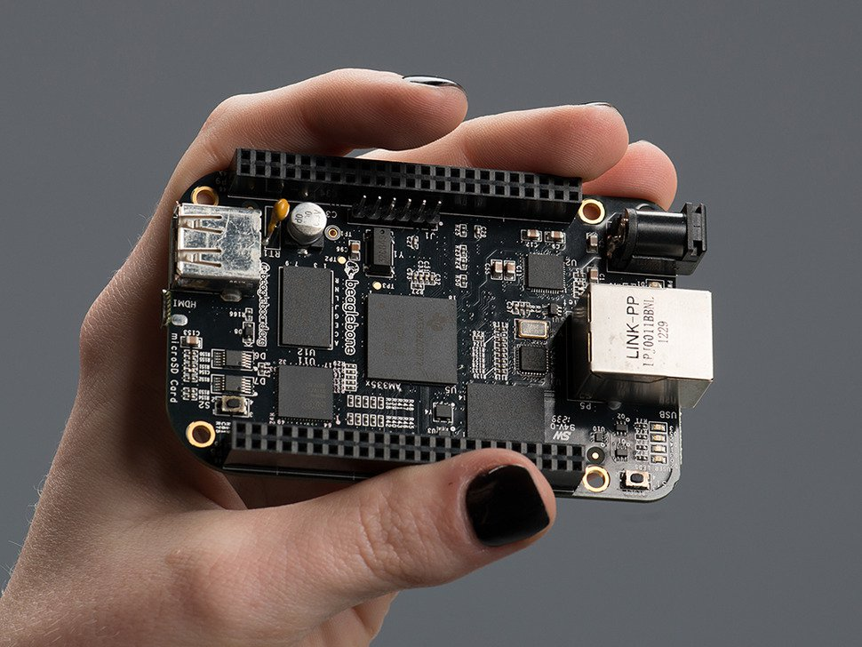
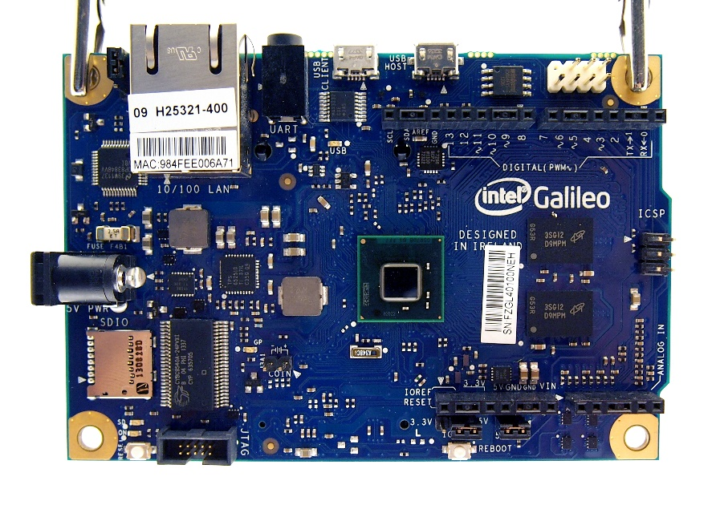
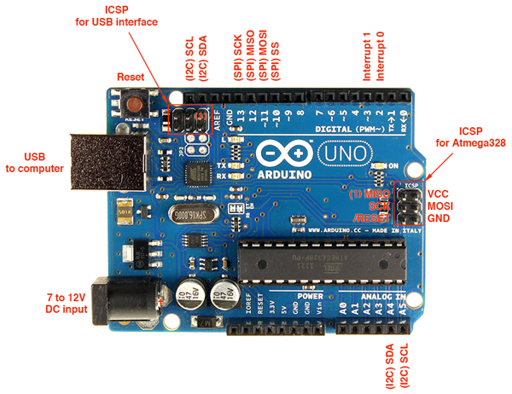
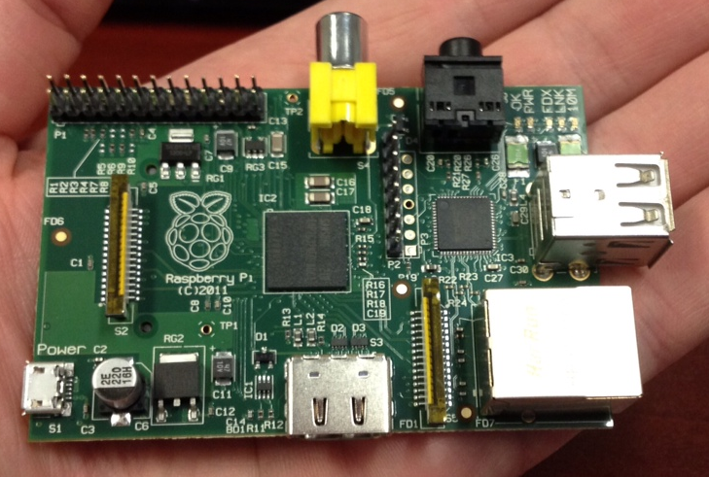
Implementing Smart Objects
Beaglebone black
Intel Galileo
Raspberry Pi
Arduino Uno

Slide 29
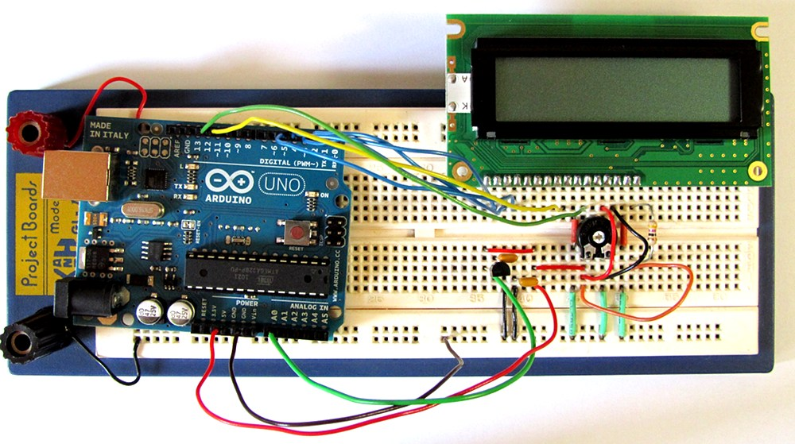
Board Connection

Slide 30
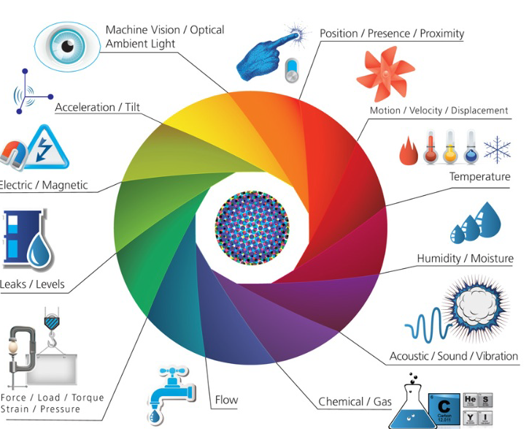
Sensors and Actuators

Slide 31
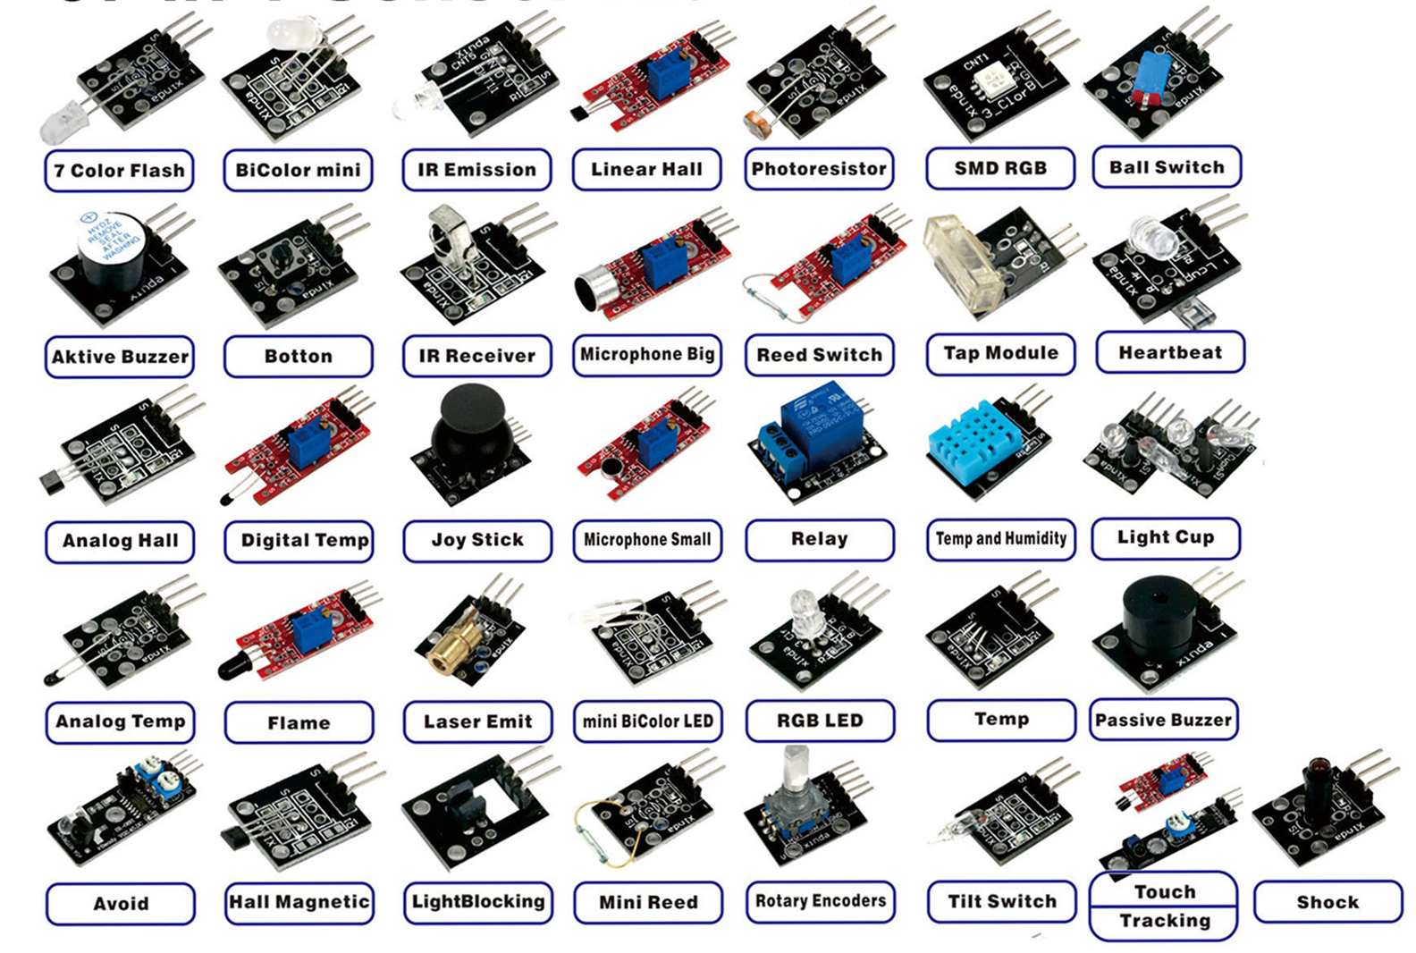
Sensors available in Market

Slide 32
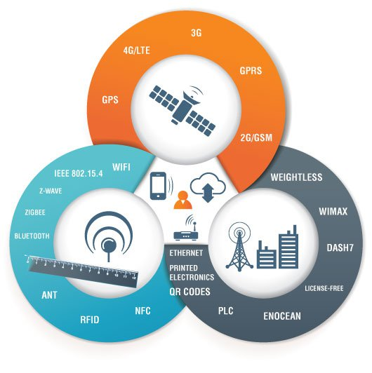
IoT Technologies : Communication Technology

Slide 33
IoT Technologies : Protocols
CoAP ( Constrained Application Protocol)
MQTT (Message Queue Telemetry Transport)
XMPP (Extensible Messaging and Presence Protocol)
6LoWPAN (Low power Wireless Personal Area Networks)

Slide 34
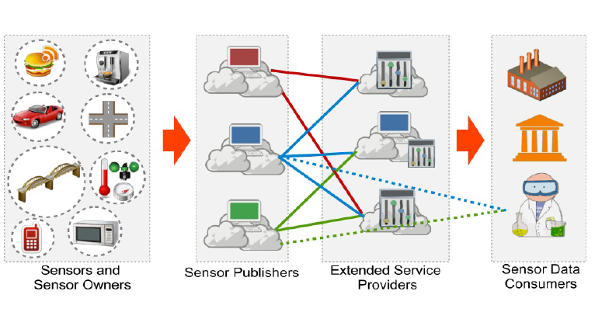
IoT Technologies : Cloud (Sensing as-a-service Model)

Slide 35
Challenges of IoT
Connectivity
Power Management
Security
Rapid Evolution

Slide 36
Thank you !

